Slide 1

A Slice of
Raspberry Pi

Slide 2
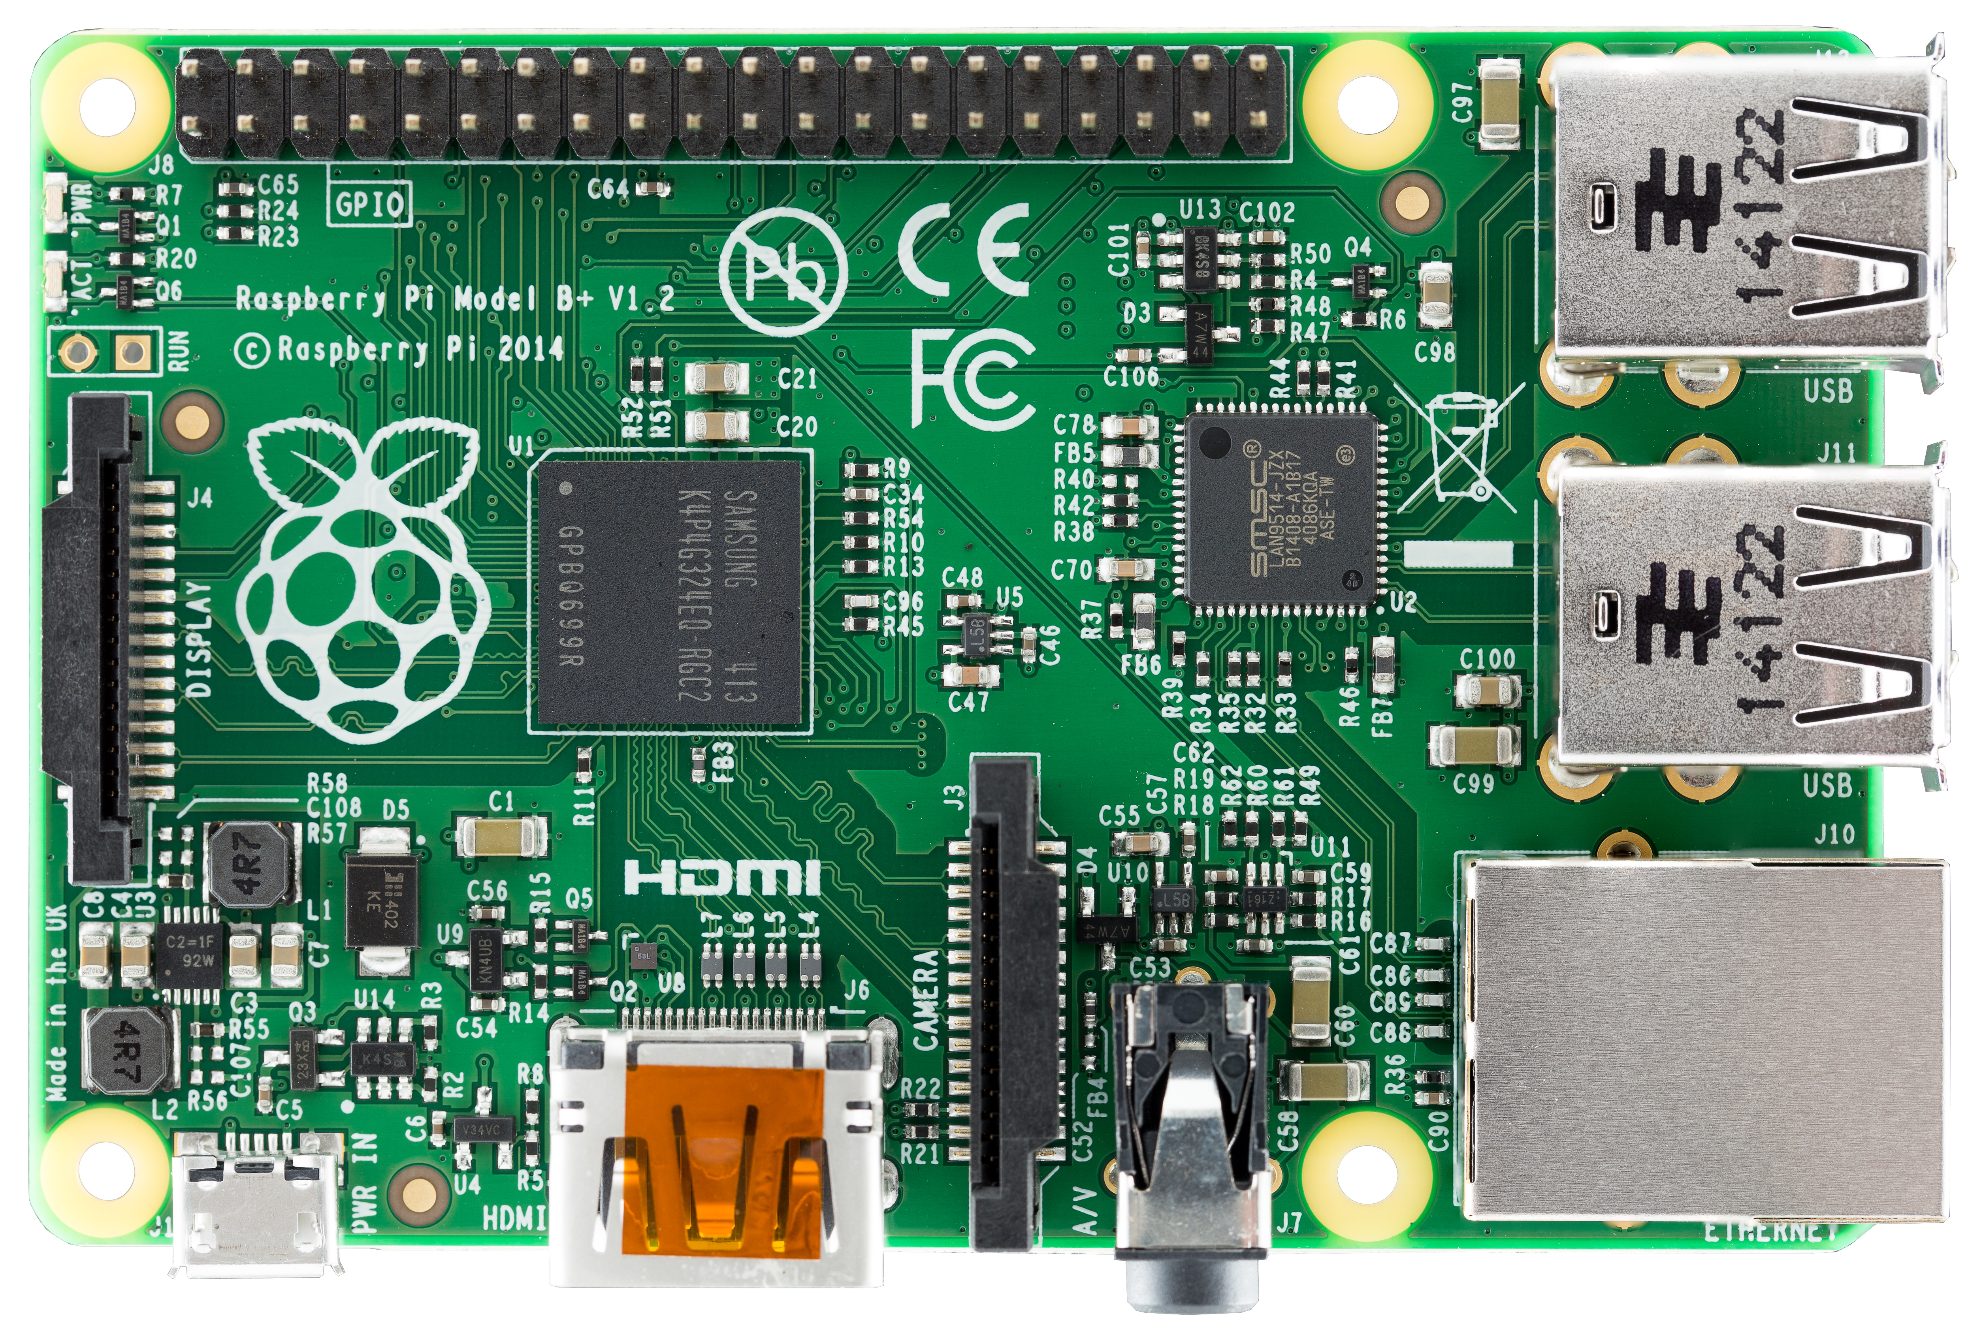
Class goals
Write a program called piTempLogger.py that
Links services to an LED indicator
Uses a 7 segment display to show more data.
Reads temperature from a sensor
Emails the temperature to yourself

Slide 3

Python

Slide 4
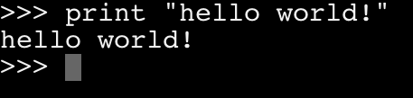
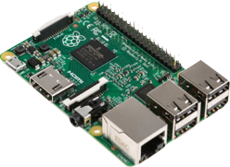
Hello world!
Open terminal or command prompt and type in “python”
In python, type in the following:
print "hello world"
Hello World!

Slide 5
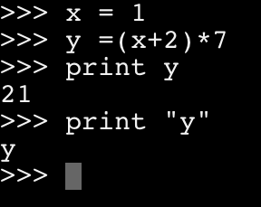
Math and Variables
Set variable by typing in
x = 1
Multiply, divide, add, subtract
* / + -
Print variables by omitting quotes
print x

Slide 6
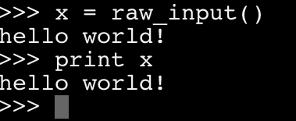
Input
Prompts the user to enter text and saves it to a variable
x = raw_input()

Slide 7

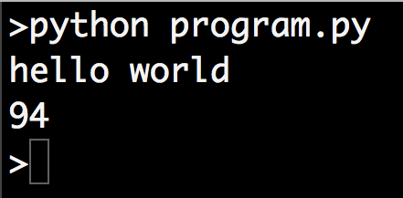
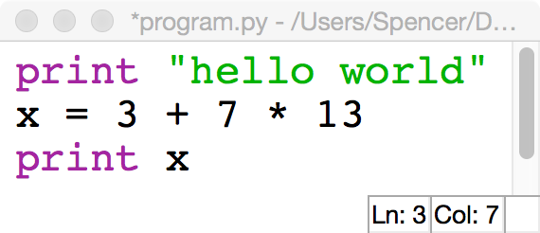
Multi line programs
In a new file
called ‘program.py’
Type in all commands into a text file using idle
Save said file as program.py
Close out of the python REPL
Open your program by typing in “python program.py”

Slide 8
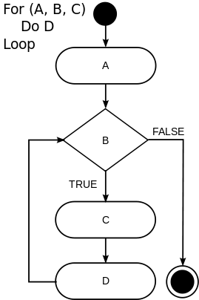
For loops
In a new file
called ‘logger.py’
Again and again
For loops count between 2 numbers.
Code in for’s are indented by spaces, and conditions are ended with colons.
for x in range(0, 10): print x print “goodbye”

Slide 9

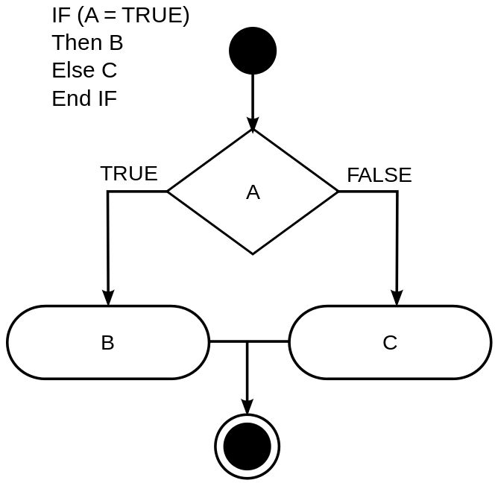
Ifs
In ‘logger.py’
If this, then that
Ifs execute different code depending on a condition.
Code in ifs are indented by spaces, and conditions are ended with colons.
for x in range(0, 10): if x == 2: print(“Hello World”) elif x == 3: print(“Hallo Weld”) else: print(“Hola Mundo”) print “goodbye”

Slide 10
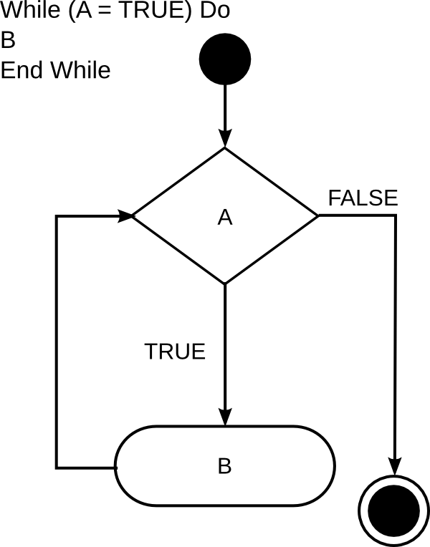
While loops
In ‘logger.py’
Déjà vu
While loops repeat code while a condition is true.
Code in while loops are indented by spaces, and conditions are ended with colons.
x = 0 while x < 10: if x == 2: print(“Hello World”) elif x == 3: print(“Hallo Weld”) else: print(“Hola Mundo”) x = x + 1 print “goodbye”

Slide 11
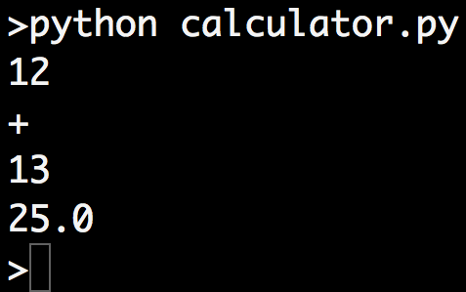
Challenge
In a new file
called ‘calc.py’
Make a 4 function calculator in python that takes in a number, then an operation (+-*/), and finally an other number. The input ‘12’, then ‘+’, and finally ‘13’ should print 25.

Slide 12
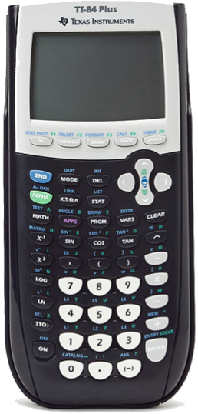
Calculator solution
x = float(raw_input()) op = raw_input() y = float(raw_input()) if op == '+': n = x + y elif op == '-': n = x - y elif op == '*': n = x * y elif op == ‘/‘: n = x / y print(n)

Slide 13
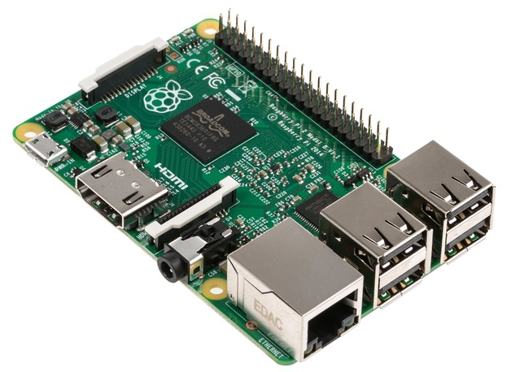
GPIO
GPIO, or General Purpose Input/Output port, is your Pi’s gate to the outside world. It can be used to read values for sensors, or activate LEDs or motors. It can be used in python by using the GPIO module. import RPi.GPIO as GPIO

Slide 14

Blinking an LED
In ‘logger.py’
#import GPIO module import RPi.GPIO as GPIO #import time for sleep function import time #initialize GPIO to use Raspberry Pi pinouts GPIO.setmode(GPIO.BOARD) #set pin 7 to output mode GPIO.setup(15, GPIO.OUT) while True: #turn on LED and wait 1 second GPIO.output(15,True) time.sleep(1) #turn off LED and wait 1 second GPIO.output(15,False) time.sleep(1)

Slide 15
GPIO 22
3v3
GND

Slide 16
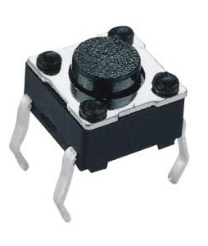
Input from buttons
In ‘logger.py’
#get access to GPIO module import RPi.GPIO as GPIO #set up pins GPIO.setmode(GPIO.BOARD) GPIO.setup(14, GPIO.IN) GPIO.setup(15, GPIO.OUT) #check whether button is pressed and #change LED accordingly while True: button = GPIO.input(14) GPIO.output(15,button)

Slide 17
GPIO 22
3v3
GND
GPIO 23

Slide 18
Challenge
In ‘logger.py’
Make a program that blinks the LED while the button is released, and stops blinking when the button is pressed.

Slide 19
Blinker solution
#import GPIO module import RPi.GPIO as GPIO #import time for sleep function import time #initialize GPIO to use Raspberry Pi pinouts GPIO.setmode(GPIO.BOARD) #set pin 7 to output mode GPIO.setup(15, GPIO.OUT) GPIO.setup(14, GPIO.IN) while True: button = GPIO.input(14) while button == True: print 'waiting' #turn on LED and wait 1 second GPIO.output(15,True) time.sleep(1)
#turn off LED and wait 1 second GPIO.output(15,False) time.sleep(1)

Slide 20
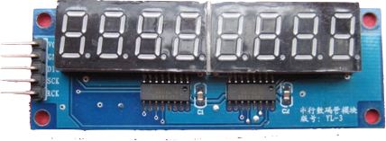
7 segment displays
In a new file
called ‘temp.py’
7 segment displays operate through a custom module called PiSlice
Set display by using PiSlice.display_number import PiSlice PiSlice.init() PiSlice.number = 12345678

Slide 21
GPIO 22
GPIO 23
GPIO 27
GPIO 17
GPIO 18
GND
3v3

Slide 22
Challenge
Add up the number of times you press the button and display it on the 7 segment displays incrementing each time you press the button.
In ‘logger.py’

Slide 23
Counter solution
#import GPIO module and PiSlice module import RPi.GPIO as GPIO import PiSlice #start up 7 segment display PiSlice.init() num = 0 while True: button = GPIO.input(14) while button == 0: button = GPIO.input(14) while button == 1: button = GPIO.input(14) num = num + 1 PiSlice.number = num

Slide 24
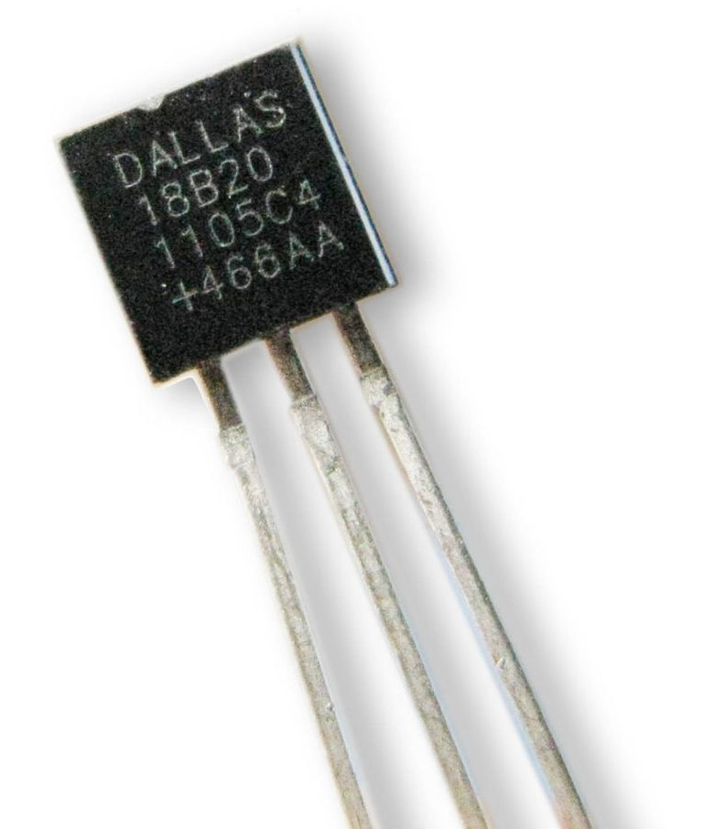
Sensing temperature
In ‘temp.py’
import PiSlice PiSlice.init() PiSlice.init_temp() while True: f, c = PiSlice.read_temp() PiSlice.number = f

Slide 25
GPIO 22
GPIO 23
GPIO 27
GPIO 17
GPIO 18
GND
3v3
GPIO 4

Slide 26

Pi in the sky
Getting your Raspberry Pi project online

Slide 27

Email
Python can send and receive emails using the SMTP protocol.
You can send yourself data logged from the pi over email
Your email address is LetsCodePi@gmail.com
The password is LetsCode

Slide 28

Sending emails
In a new file
called ‘mail.py’
import smtplib
fromaddr = 'LetsCodePi@gmail.com'
toaddrs = 'to@addr.com'
msg = 'testing'
# Credentials (if needed)
username = 'LetsCodePi@gmail.com'
password = 'LetsCode'
# The actual mail send
server = smtplib.SMTP('smtp.gmail.com:587')
server.ehlo()
server.starttls()
server.ehlo()
server.login(username,password)
server.sendmail(fromaddr, toaddrs, msg)
server.quit()

Slide 29
Final challenge
In ‘logger.py’
Make a program based off of the button counter that can show the number of emails you have and the current room's temperature. Cycle through these modes by pressing the button and display your output on the 7 segment displays.

